Slide 1


Chapter 3 Relational Model
Instructor: He Li
Notes:
This chapter describes logical database design in the relational data model. Logical database design is the process of transforming the conceptual data model (i.e., ERD and/or EER described in Chapter 2) into a logical data model. Logical database design is about creating stable database structures.

Slide 2
Components of Relational Model
Data Structure (tables, rows, columns)
Data Integrity (specify business rules to maintain data integrity)
Data Manipulation (operations to manipulate data, typically using SQL language)
Notes:
Although there are some other logical data models, we have two reasons for emphasizing the relational data model. First, the relational data model is by far the most used in database applications. Second, most principles of logical database design for the relational model also apply to other logical models.
The relational model is based on mathematical theory, and therefore has a solid theoretical foundation. It includes three components:
Data structure Data are organized in the form of tables, with rows and columns.
Data integrity The model includes mechanisms to specify business rules that maintain the integrity of data when they are manipulated.
Data manipulation Powerful operations (typically implemented using the SQL language) are used to manipulate data stored in the relations.
We discuss data structure and data integrity in this chapter. Data manipulation will be covered in the next chapter.

Slide 3

Relation – two-dimensional (columns and rows) table of data
Relation
Table
Each row needs to have a primary key
Notes:
A relation is a named, two-dimensional table of data. Each relation (or table) consists of a set of named columns and an arbitrary number of unnamed rows.
Here is an example of a relation named EMPLOYEE1. This relation contains the following attributes describing employees: EmpID, Name, DeptName, and Salary. The five rows of the table correspond to five employees.
We can express the structure of a relation by using a shorthand notation: the relation name is followed by its attributes (in parentheses).
All relations are tables, but not all tables are relations. Think of a “table” as simply being a grid with rows and columns. In this sense, a spreadsheet could be a “table”. To qualify as a relation, each row would need to be unique, which implies that each row needs to have a primary key.

Slide 4
E-R Model
Relational Model
Entity Types
M:M Relationship Types
Relations (Tables)
Entity Instances
M:M Relationship Instances
Rows
Attributes
Columns
Primary Key (identifiers of the relation)
Foreign Key (identifiers that enable a dependent relation to refer to its parent relation)
e.g., EMPLOYEE1(EmpID, Name, DeptName)
DEPARTMENT(DeptName, Location, Fax)
Identifier
Notes:
Relational models can be matched to the ER model.
Entity types and many-to-many relationship types in ER model correspond to Relations (tables) in the relational model.
Entity instances and many-to-many relationship instances are rows in the relational model.
ER model’s attributes are columns in the relational model.
Identifiers in the ER model will be transformed to keys in the relational databases. A primary key is an attribute or a combination of attributes that uniquely identifies each row in a relation. For example, EmployeeID is the primary key for the relation EMPLOYEE. We designate a primary key by underlining the attribute name(s).
The relationship between two tables will be accomplished through foreign keys. A foreign key is an attribute in a relation that serves as the primary key of another relation. For example, the attribute DeptName is a foreign key in EMPLOYEE, which allows a user to associate any employee with the department to which s/he is assigned. We use a dashed underline to indicate the attribute as a foreign key.
Same with identifiers in the ER model, keys can be single or composite.
Note that the words “relation” and “relationship” are not the same.

Slide 5
Integrity Constraints
Domain Constraints
Entity Integrity
Referential Integrity
Allowable values for an attributes (i.e., data types of value restrictions)
Foreign key MUST match a primary key OR NULL
Primary key is NOT NULL
Notes:
The relational data model includes several types of constraints, or rules limiting acceptable values and actions. The purpose is to facilitate maintaining the accuracy and integrity of data in the database. The major types of integrity constraints are domain constraints, entity integrity, and referential integrity.
Domain Constraints means that all values in a column must be from the same domain. A domain is the set of possible values for an attribute.
With the entity integrity rule, primary key attribute (or any component of a primary key attribute) cannot be null.
A referential integrity constraint is a rule that maintains consistency among the rows of two relations. If there is a foreign key in one relation, either each foreign key value must match a primary key value in another relation, or the foreign key value must be null.
Referential integrity rules prevent data from being deleted when there is other data dependent on it. For example, a customer will not be deleted from the database if the customer has other existing orders. The delete rules specify how such deletions can be controlled within the database.

Slide 6
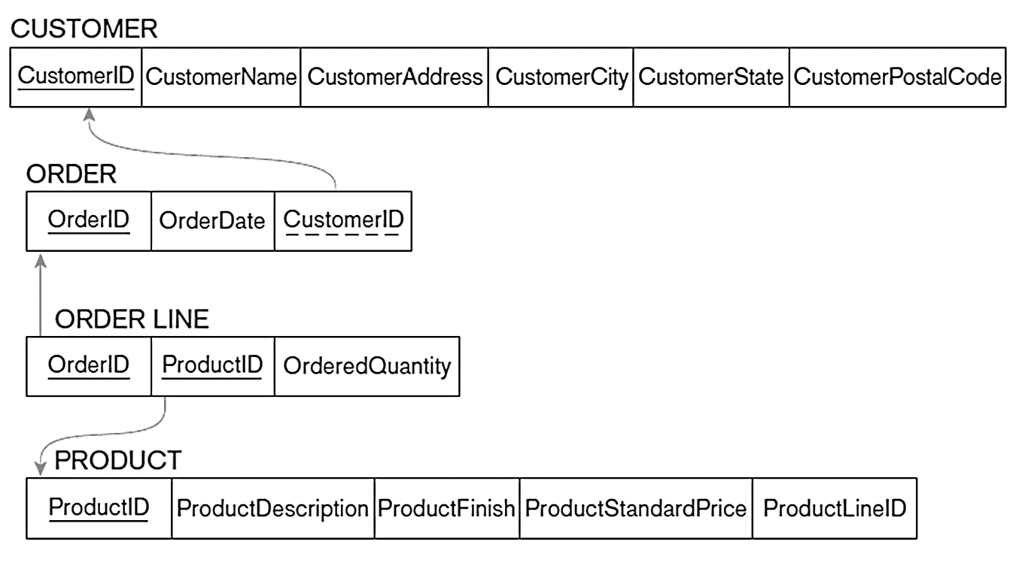
Example of Referential Integrity Constraints
Notes:
Graphically, arrows between foreign and primary keys depict referential integrity constraints.

Slide 7
Converting EER to Relations
1. Mapping Regular Entities to Relations
1.1 Simple attributes
1.2 Composite attributes
1.3 Multivalued attributes
2. Mapping Weak Entities to Relations
3. Mapping Binary Relationships to Relations
3.1 One-to-Many
3.2 Many-to-Many
3.3 One-to-One
4. Mapping Associative Entities to Relations
4.1 Identifier not assigned
4.2 Identifier assigned
5. Mapping Unary Relationships to Relations
5.1 One-to-Many
5.2 Many-to-Many
6. Mapping Ternary (and n-ary) Relationships to Relations
Notes:
After developing the conceptual model (ERD or EER), we can convert it to the relational database design. If you do a thorough job of developing the conceptual model, it should be a fairly simple matter to convert this to a well-structured relational database.

Slide 8

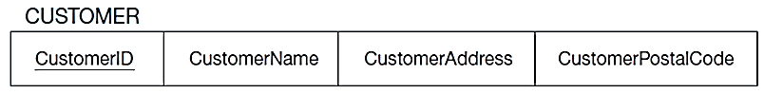
Step 1.1: Regular Entity with Simple Attributes
Rule of Thumb: E-R attributes map directly onto the relation
Notes:
For a regular entity, it is very simple. Each attribute of the entity becomes a column of the resulting relation. The identifier of the entity becomes a primary key in the relation.

Slide 9
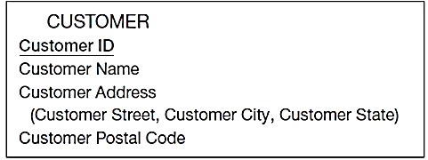
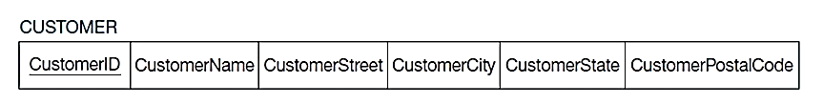
Step 1.2: Regular Entity with a Composite Attribute
Rule of Thumb: Use only their simple, component attributes
Notes:
For each composite attribute, the component attributes become individual columns. As shown in the example, there is no field called “Customer Address” in the relation. Instead, we use its component, including CustomerStreet, CustomerCity, and CustomerState.

Slide 10

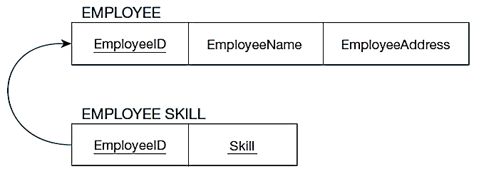
Step 1.3: Regular Entity with a Multivalued Attribute
Rule of Thumb: Become a separate relation with a foreign key taken from the superior entity
Notes:
Multivalued attributes in E-R models must be converted to separate relations in the logical database design. Because there is no such thing as a multivalued attribute in relational databases. In this case, there is a one-to-many relationship in the final database structure. The Employee Skill relation has a composite primary key (EmployeeID and Skill). The EmployeeID portion of this composite primary key is also a foreign key to the Employee table.

Slide 11
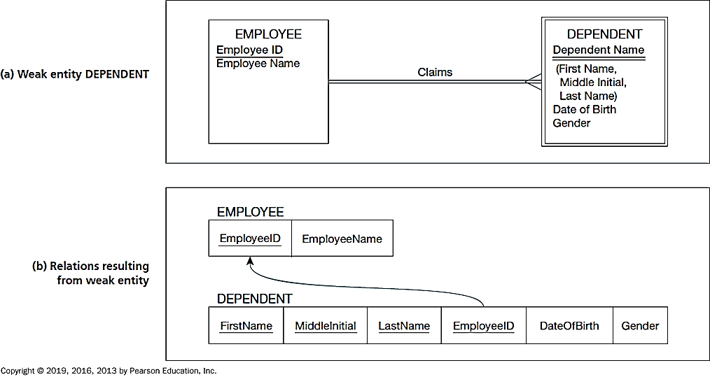
Step 2: Weak Entities
Rule of Thumb: (1) Becomes a separate relation with a foreign key taken from the superior entity; and (2) Primary key composed of: partial identifier of weak entity and primary key of identifying relation (strong entity)
Notes:
For a weak entity, we firstly create a separate relation for the weak entity and include the primary key from the strong entity as the weak entity’s foreign key. The partial identifier of weak entity and primary key of identifying relation becomes the composed primary key of the weak entity.
In this employee-dependent example, EmployeeID is added as a foreign key linking to the EMPLOYEE relation. Dependent name and employee ID become a composite primary key for the DEPENDENT relation.

Slide 12
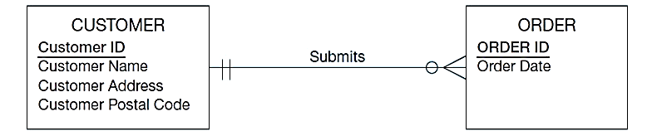
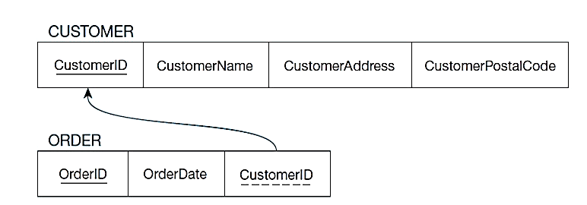
Step 3.1: Binary One-to-Many Relationship
Rule of Thumb: Primary key on the one side becomes a foreign key on the many side
Notes:
For a one-to-many relationship, the primary key on the one side becomes a foreign key on the many side. In this example, we add CustomerID to the ORDER relation as a foreign key linking to the CUSTOMER table.

Slide 13
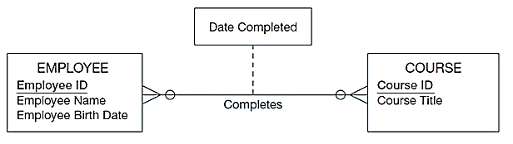
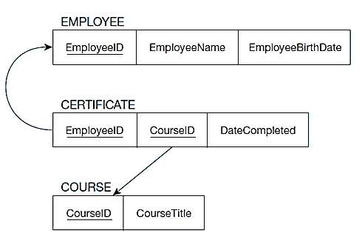
Step 3.2: Binary Many-to-Many Relationship
Rule of Thumb: Create a new relation with the primary keys of the two entities as its primary key
Notes:
For a many-to-many relationship, whether or not it contains attributes on the relationship, it must be implemented as a separate relation. Often this is called an intersection table or junction table. In this example, we create a new table CERTIFICATE, and its primary key is composite, formed by two foreign keys, EmployeeID and CourseID. The attribute on the relationship DateCompleted is included in the third intersection table.

Slide 14
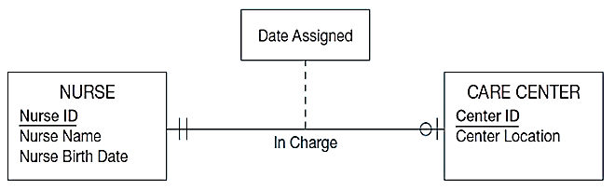
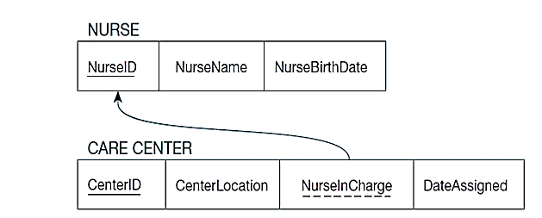
Step 3.3: Binary One-to-One Relationship
Rule of Thumb: Primary key on mandatory side becomes a foreign key on optional side
Notes:
For binary one-to-one relationship, primary key on mandatory side becomes a foreign key on optional side. This E-R diagram shows that a nurse could be in charge of at most one care center, and that each care center must have exactly one nurse in charge.
So, since the care center must have a charge nurse, the foreign key in this relationship goes into the Care Center table. Also, because of the mandatory one in the relationship, this must mean that the NurseInCharge field can never have a null value.

Slide 15
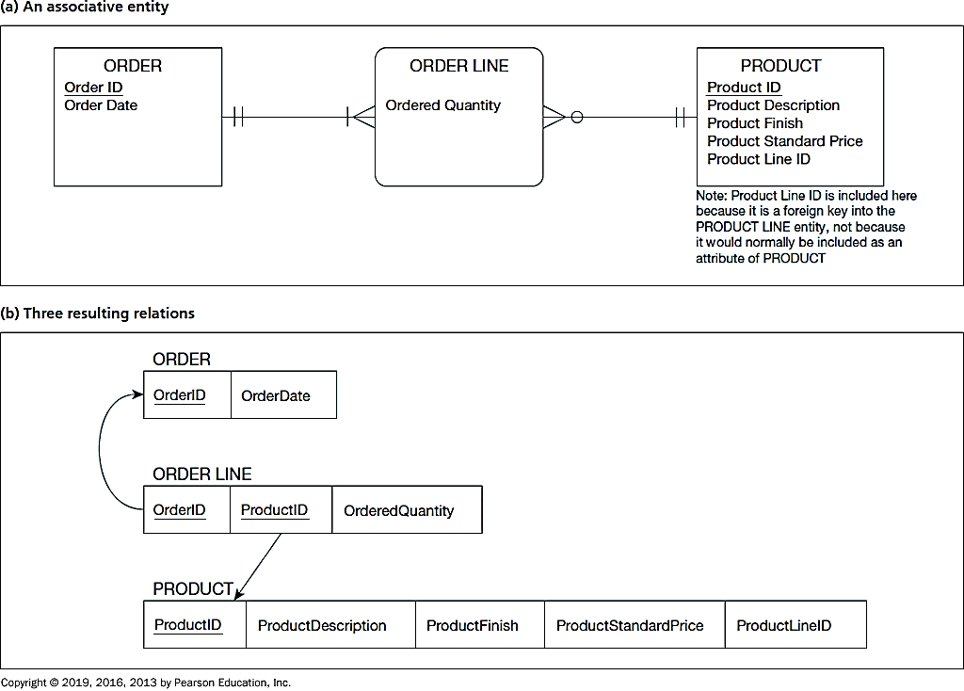
Step 4.1: Associative Entity (Identifier Not Assigned)
Rule of Thumb: Default primary key for the association relation is composed of the primary keys of the two entities (as in M:N relationship)
Notes:
Associative entities will map onto intersection tables in the resulting logical database design.
Here, Order Line, which implements a M:N relationship between Order and Product, is explicitly modelled as an associative entity.
The resulting intersection table ORDER LINE connects tables ORDER and PRODUCT. Mapping associative entities to relational databases is the same to mapping M:N relationships to relational databases.

Slide 16
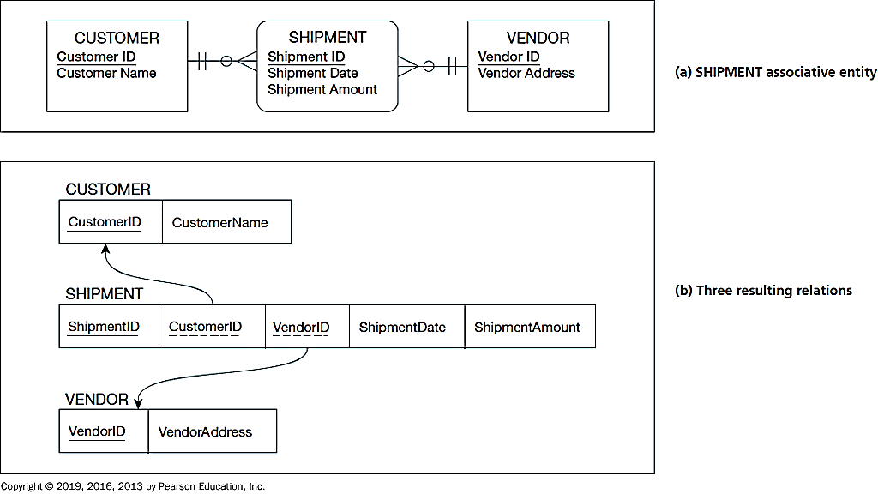
Step 4.2: Associative Entity (Identifier Assigned)
Rule of Thumb: Use primary keys of associated entities as foreign keys in the associative entity.
Notes:
Sometimes, the associative entity has its own identifier. In this case, we use the identifier ShipmentID as the primary key of the intersection table SHIPMENT. Its foreign keys CustomerID and VendorID are not part of the primary key. So, it is possible to have multiple shipments from the same vendor to the same customer.

Slide 17
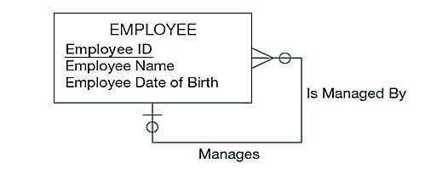
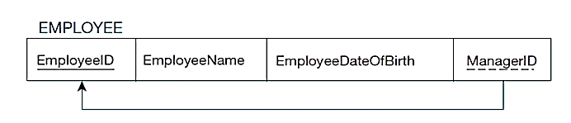
Step 5.1: Unary One-to-Many Relationship
Rule of Thumb: Recursive foreign key in the same relation
Notes:
The E-R diagram involves a one-to-many relationship. Thus, the foreign key is in the same table as the primary key. This is often called a “recursive” key because it points at records in the same table.
Because of the optional relationship, it is possible for an employee not to have any supervisor. Therefore, the ManagerID field could be null. This structure is an example of storing hierarchies. It enables the representation of a supervisor who has subordinates, and these subordinates could in turn manage other subordinates, etc.

Slide 18
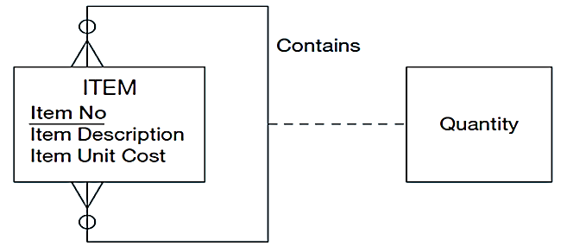
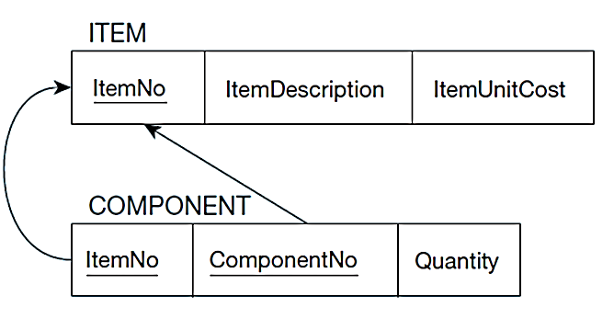
Step 5.2: Unary Many-to-Many Relationship
Rule of Thumb: Use two relations: (1) one for the entity type; and (2) one for an associative relation in which the primary key has two attributes, both taken from the primary key of the entity
Notes:
As always, any many-to-many relationship requires a separate relation. In this example, we create a new table COMPONENT, and use the same primary key ItemNo, then add a foreign key ComponentNo linking back to the main table ITEM.

Slide 19
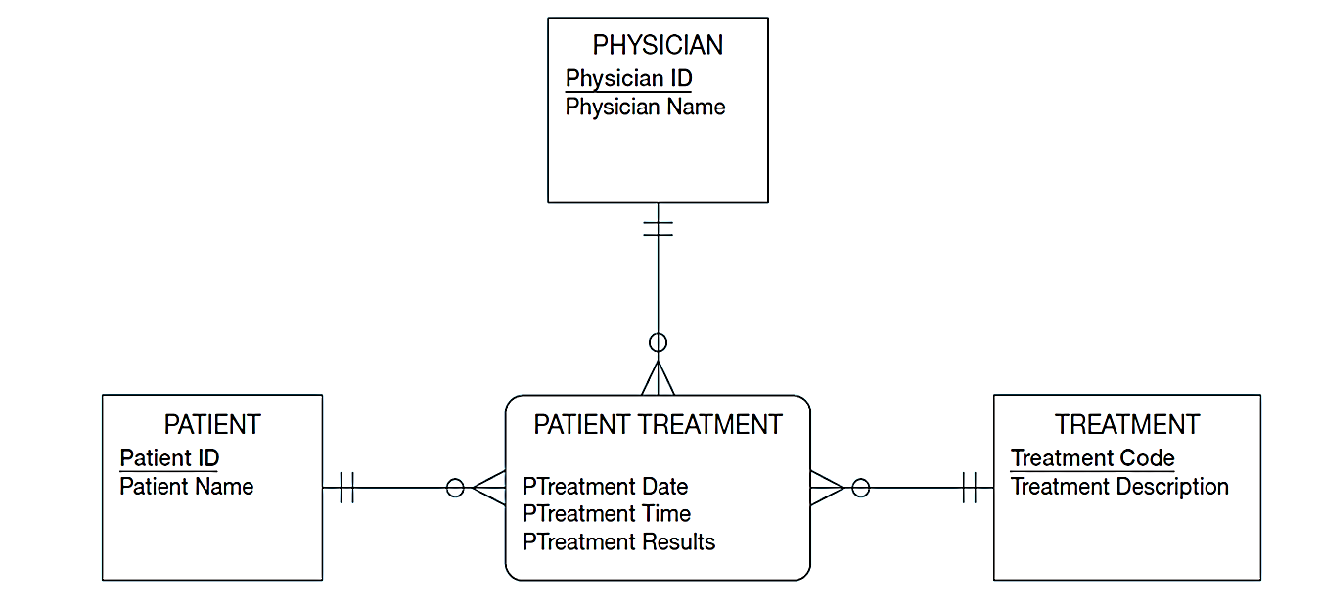
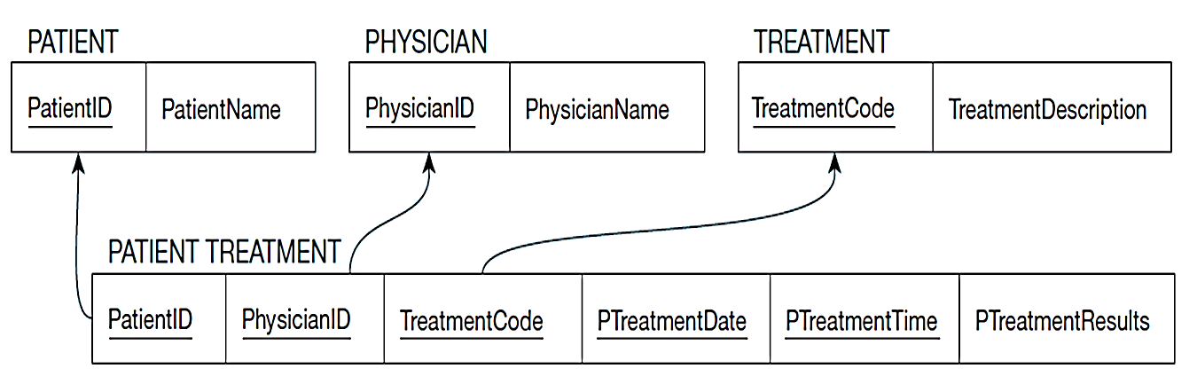
Step 6: Ternary Relationship
Rule of Thumb:
One relation for each entity and one for the associative entity
Associative entity has foreign keys to each entity in the relationship
Notes:
To map a ternary or n-ary relationships, we create one relation for each entity and one relation for the associative entity. Associative entity will have foreign keys to each entity in the relationship.
Here, we look at one ternary example. Note that this E-R diagram shows that a given physician can give a treatment to a patient, and that this could happen more than once.
The primary key MUST be unique. So, the primary key of the PATIENT TREATMENT table needs more than just the three foreign keys to Physician, Treatment, and Patient. If the composite primary key was composed of just the foreign keys, then a given physician could make a particular treatment for a particular patient only once. So, date and time are part of the primary key. This way a physician may give the same treatment to the same patient multiple times, but only once at each date/time.
But this creates a primary key consisting of five separate columns. The table now has a five-field foreign key. We often simplify it by creating a surrogate primary key like TreatmentID.

Slide 20
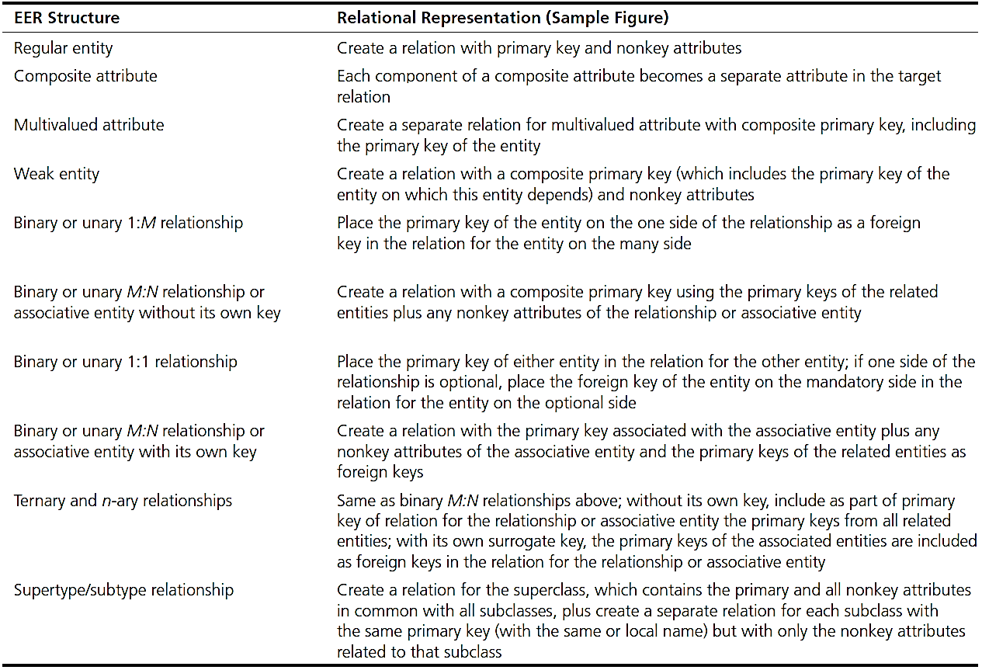
Summary: Converting EER to Relations
Notes:
These steps provide a comprehensive explanation of how each element of an EER diagram is transformed into parts of a relational data model. Here is a quick reference to these steps that illustrate each type of transformation.

Slide 21
Normalization – a tool to validate and improve a logical design
Goal
Contain minimal data redundancy
Avoid anomalies
Insertion Anomaly
Modification Anomaly
Deletion Anomaly
produce well-structured relations
adding new rows forces user to create duplicate data
deleting rows may cause a loss of data that would be needed for other future rows
changing data in a row forces changes to other rows because of duplication
Notes:
We showed how to map an E-R model to a relational database design. If you follow these mappings, then your result will be a well-structured database. However, there is no guarantee that all anomalies are removed. Sometimes, organizations just start by creating tables without considering the E-R rules. Then you will likely get a database that is not well-structured.
These databases could cause anomalies because of data duplication. Some common anomalies, for example: insertion anomaly means that adding new rows forces user to create duplicate data. Deletion anomaly refer to the case that deleting rows may cause a loss of data that would be needed for other future rows. With modification anomaly, changing data in a row forces changes to other rows because of duplication.
We can correct these anomalies through a process called “normalization”. The goal of normalization is to contain minimal data redundancy and avoid anomalies.

Slide 22
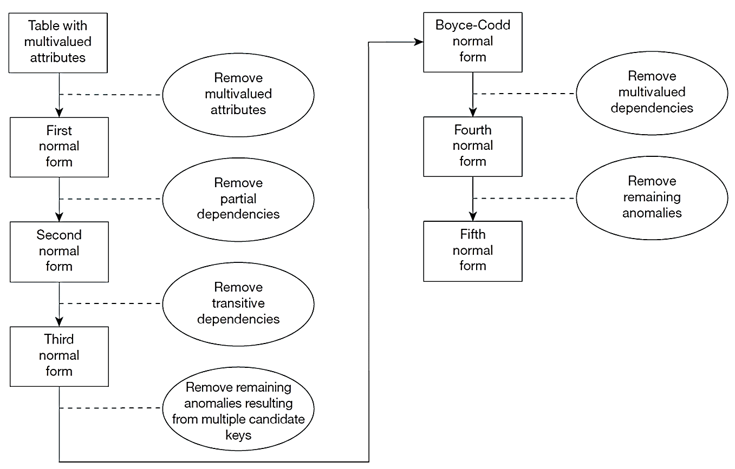
Steps in Normalization
Notes:
Normalization can be accomplished and understood in stages, each of which corresponds to a normal form. A normal form is a state of a relation that requires to satisfy certain rules regarding relationships between attributes (or functional dependencies). We describe these rules briefly in this section and illustrate them in detail in the following sections:
First normal form Any multivalued attributes (also called repeating groups) have been removed, so there is a single value (possibly null) at the intersection of each row and column of the table.
Second normal form Any partial functional dependencies have been removed (i.e., nonkey attributes are identified by the whole primary key).
Third normal form Any transitive dependencies have been removed (i.e., nonkey attributes are identified by only the primary key).
Boyce-Codd normal form Any remaining anomalies that result from functional dependencies have been removed (because there was more than one possible primary key for the same nonkeys).
Fourth normal form Any multivalued dependencies have been removed.
Fifth normal form Any remaining anomalies have been removed.

Slide 23
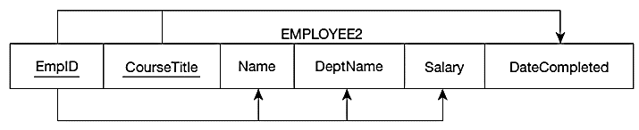
Functional Dependencies – The value of one attribute determines the value of another attribute.
Two Types of Functional Dependencies:
1. EmpID → Name, DeptName, Salary
2. EmpID, CourseTitle → DateCompleted
Candidate Key = a unique identifier
One of the candidate keys will become the primary key.
Each non-key field is functionally dependent on every candidate key.
Notes:
Up to the BC norm, normalization is based on the analysis of functional dependencies. A functional dependency is a constraint between two attributes or two sets of attributes. For any relation R, attribute B is functionally dependent on attribute A if, for every valid instance of A uniquely determines the value of B. A functional dependency is not a mathematical dependency: B cannot be computed from A. Rather, if you know the value of A, there can be only one value for B.
For example, Name, DeptName, and Salary functionally depends on EmpID. DataCompleted has functional dependencies and EmpID and CourseTitle.
As shown here, The functional dependency is represented by an arrow. The attribute on the left side of the arrow in a functional dependency is called a determinant. EmpID and CourseTitle is the determinant in the second identified functional dependency.
An effective way to decide functional dependencies is to identify candidate keys. A candidate key is an attribute, or combination of attributes, that uniquely identifies a row in a relation. One of the candidate keys will become the primary key. For example, perhaps there is both credit card number and social security number in a table. In this case, both are candidate keys. So, both will functionally determine other attributes in the table.

Slide 24
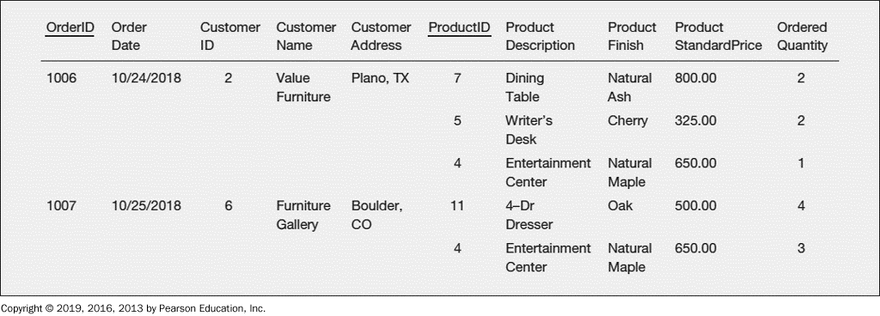
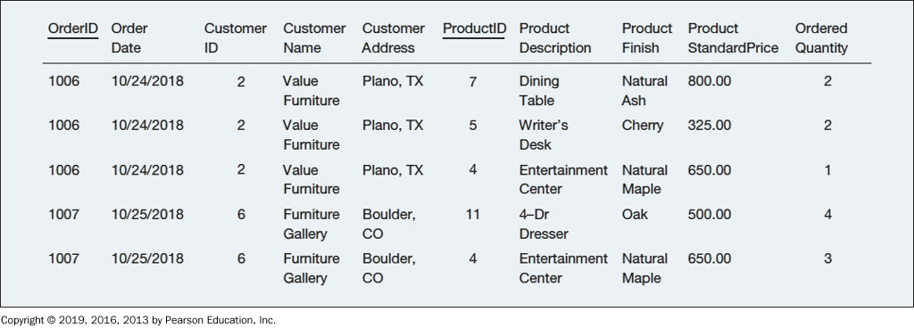
Step 1.1: Converting to First Normal Form (1NF) – remove repeating groups
Remove repeating groups
Notes:
Having examined functional dependencies and keys, we are ready to describe and illustrate the steps of normalization. For a simple illustration, we use an example of a customer invoice from a Furniture Company.
1NF shouldn’t contain repeating groups and primary key should be defined.
As you can see, the invoice data in the upper figure contain a repeating group for each product that appears on a particular order. Thus, OrderID 1006 contains three repeating groups, corresponding to the three products on that order. In a previous section, we showed how to remove repeating groups from a table by filling relevant data values into previously vacant cells of the table, as the bottom figure shows.

Slide 25
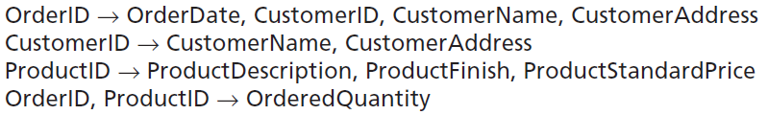
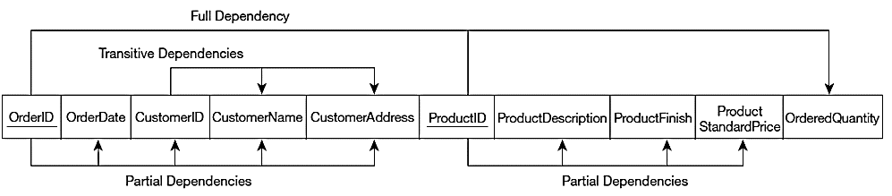
Step 1.2: Converting to First Normal Form (1NF) – identify primary keys
In this example, there are four determinants and functions dependencies:
Notes:
There are four determinants in INVOICE, and their functional dependencies are the following. Why do we know these are the functional dependencies? These business rules usually come from the organization.
As you can see, the only candidate key for INVOICE is the composite key consisting of the attributes OrderID and ProductID (because there is only one row in the table for any combination of values for these attributes). Therefore, OrderID and ProductID are underlined in the figure, indicating that they compose the primary key.
This diagram is a horizontal list of all the attributes in INVOICE, with the primary key attributes (OrderID and ProductID) underlined. Notice that the only attribute that depends on the full key is OrderedQuantity. All of the other functional dependencies are either partial dependencies or transitive dependencies (both are defined next).

Slide 26
Step 2: Converting to Second Normal Form (2NF)
1NF + every non-key attribute is fully functionally dependent on the ENTIRE primary key
Every non-key attribute must be defined by the entire key, not by only part of the key
No partial functional dependencies
To convert a relation with partial dependencies to second normal form, the following steps are required:
Create a new relation for each primary key attribute (or combination of attributes) that is a determinant in a partial dependency. That attribute is the primary key in the new relation.
Move the non-key attributes that are only dependent on this primary key attribute (or attributes) from the old relation to the new relation.
Notes:
We can remove many of the redundancies (and resulting anomalies) in the INVOICE relation by converting it to second normal form. A relation is in second normal form (2NF) if it is in first normal form and contains no partial functional dependencies. A partial functional dependency exists when a nonkey attribute is functionally dependent on part (but not all) of the primary key.
Two steps to convert a relation to 2NF. First, create a new relation for each primary key attribute (or combination of attributes) that is a determinant in a partial dependency. That attribute is the primary key in the new relation. Second, move the nonkey attributes that are only dependent on this primary key attribute (or attributes) from the old relation to the new relation.

Slide 27
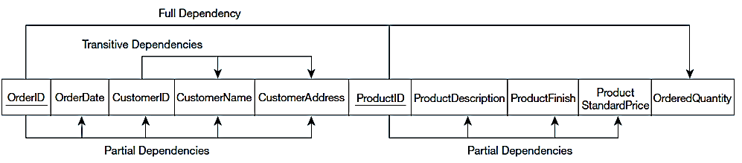
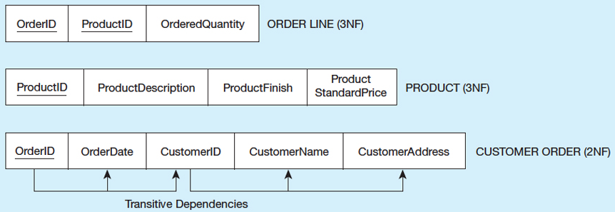
Step 2: Converting to Second Normal Form (2NF)
1NF
2NF
Notes:
Let’s continue the example and see how it works. OrderID and ProductID have two partial dependencies. We create separate relations for these two partial dependencies and remove the non-key attributes from the previous relation.

Slide 28
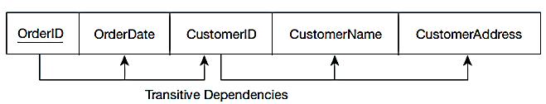
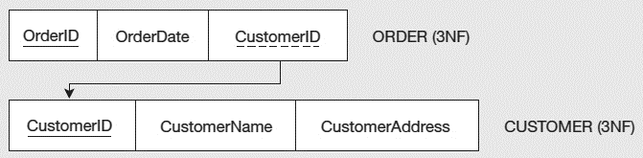
Step 3: Converting to Third Normal Form (3NF)
2N F + no transitive dependencies (functional dependencies on non-primary-key attributes)
Solution: Non-key determinant with transitive dependencies go into a new table; non-key determinant becomes primary key in the new table and stays as foreign key in the old table
Notes:
A relation is in third normal form (3NF) if it is in second normal form and no transitive dependencies exist. A transitive dependency in a relation is a functional dependency between the primary key and one or more nonkey attributes that are dependent on the primary key through another nonkey attribute. For example, in this relational table, OrderID determines CustomerID, and CustomerID determines CustomerName and CustomerAddress.
Thus, we remove the transitive dependency by creating another relation including the non-key determinant with transitive dependencies. In this example, we create a new table including CustomerID, CustomerName, and CustomerAddress. CustomerID is the primary key for the new table.
Finally we are at third normal form. At this point we have a pretty much well-structured database. As most courses covering relational database, we only require a 3NF.

